Slide 1
Server Load Balancer
jnlin

Slide 2
Introduction
More users, more resources needed
CPU, RAM, HDD …
Scale Up & Scale Out
One powerful server to service more users; or
Multiple servers to service more users
Pros & Cons ?
C10K Problem

Slide 3
Introduction
High Availability
A characteristic of a system, which aims to ensure an agreed level of operational performance, usually uptime, for a higher than normal period.
Availability (per year)
99%: 3.65days
99.9%: 8.77 hours (3 nines)
99.99%: 52.60 minutes (4 nines)
99.999%: 5.26 minutes (5 nines)

Slide 4
High Availability
Principles
Elimination of single points of failure.
Reliable crossover.
Reliable configuration / topology change
Detection of failures as they occur.
Graceful Degradation
the ability of a computer, machine, electronic system or network to maintain limited functionality even when a large portion of it has been destroyed or rendered inoperative.

Slide 5
Load Balancing
Client Side
e.g: DNS round-robin
Pros & Cons
Server Side
Server Load Balancer

Slide 6
Server Load Balancer (1)
Provide “Scale-Out” and HA features
Share loading among all backend nodes with some algorithms
Static Algorithms: does not take into account the state of the system for the distribution of tasks.
Dynamic Algorithms

Slide 7
Server Load Balancer (2)
Layer 4 or Layer 7
Layer 4 Switch
Distribution Algorithms
Round-robin
Random
Ratio
Hash Table
Least-connections
Persistence
Session-ID (e.g. HTTP Cookie)

Slide 8
Server Load Balancer (3)
Persistence (Stickiness)
“The Server” in OLG
How to handle information that must be kept across the multiple requests in a user's session.
Session ID?
Cookie
IP Address
TCP Connection
Pros & Cons ?

Slide 9
Server Load Balancer (4)
SSL offloading (SSL/TLS termination)
Pros?
Problems of Server Load Balancer
SPoF
Capacity Limit
Latency

Slide 10
Haproxy
http://www.haproxy.org
Reliable & High Performance TCP/HTTP Load Balancer
Layer 4 (TCP) and Layer 7 (HTTP) load balancing
SSL/TLS termination
Gzip compression
Health checking
HTTP/2

Slide 11
Haproxy - Installation
pkg install haproxy
You can also build it from ports
Config file: /usr/local/etc/haproxy.conf

Slide 12
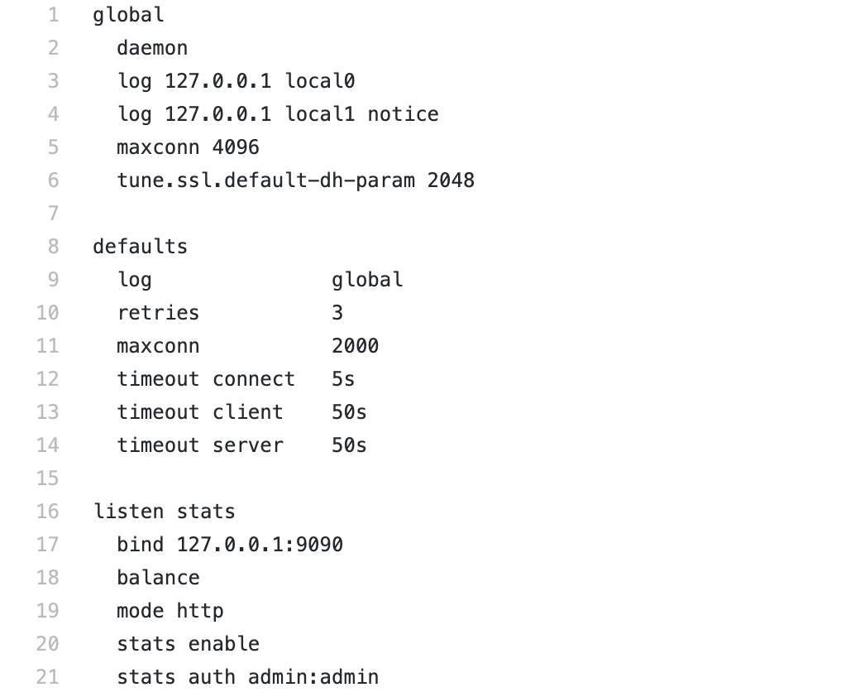
Haproxy - Configuration

Slide 13
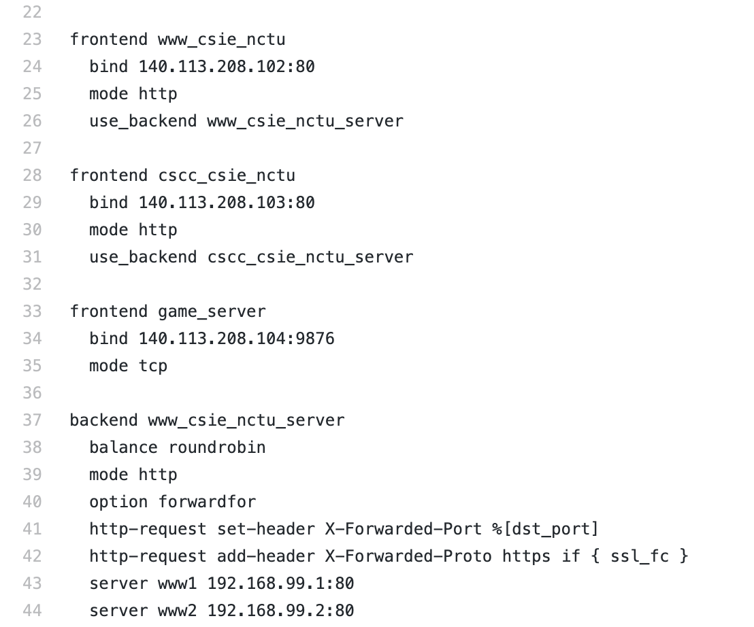
Haproxy - Configuration

Slide 14
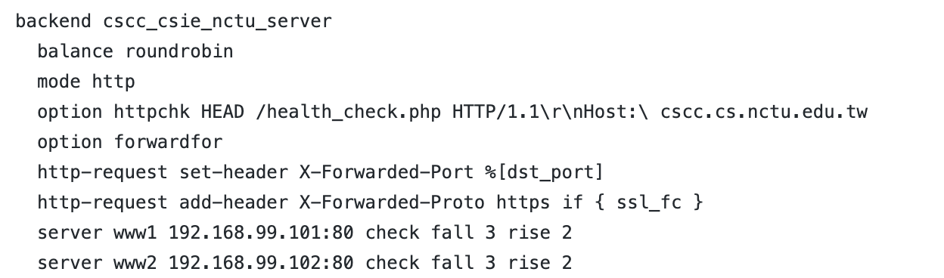
Haproxy - Configuration

Slide 15
Haproxy Configuration
global
log
chroot
uid / gid
pidfile

Slide 16
Haproxy Configuration
defaults
log
option
retries
timeout

Slide 17
Haproxy Configuration
listen
stats

Slide 18
Haproxy Configuration
frontend
bind
mode
option
use_backend

Slide 19
Haproxy Configuration
backend
balance
roundrobin, leastconn, hdr(param)
mode
http-request
server
check
fall
rise
inter
cookie

Slide 20
Haproxy - run
/etc/rc.conf.local
haproxy_enable=“YES”
/usr/local/etc/rc.d/haproxy start
Question: how to setup a backup node for haproxy?

Slide 21
Haproxy - Reference
http://cbonte.github.io/haproxy-dconv/2.1/configuration.html

Slide 22
Envoy
https://www.envoyproxy.io
Developed by Lyft (a ride-sharing company like Uber) and opensourced in 2017
Apache License 2.0
Features
Dynamic APIs for configuration
Service Discovery
gRPC / MongoDB / HTTP support

Slide 23
Envoy - Installation
Broken in FreeBSD now
You can install it on Linux instead
https://www.getenvoy.io
Debian: https://www.getenvoy.io/install/envoy/debian/
Ubuntu: https://www.getenvoy.io/install/envoy/ubuntu/
Centos: https://www.getenvoy.io/install/envoy/centos/

Slide 24
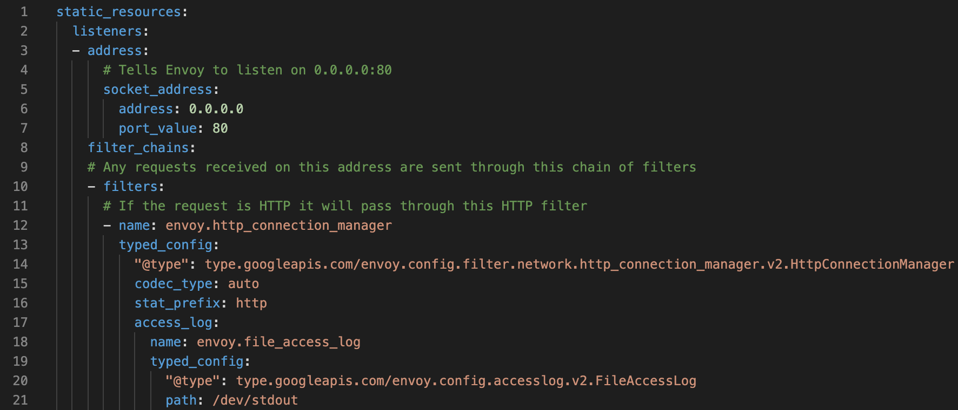
Envoy - Configuration

Slide 25
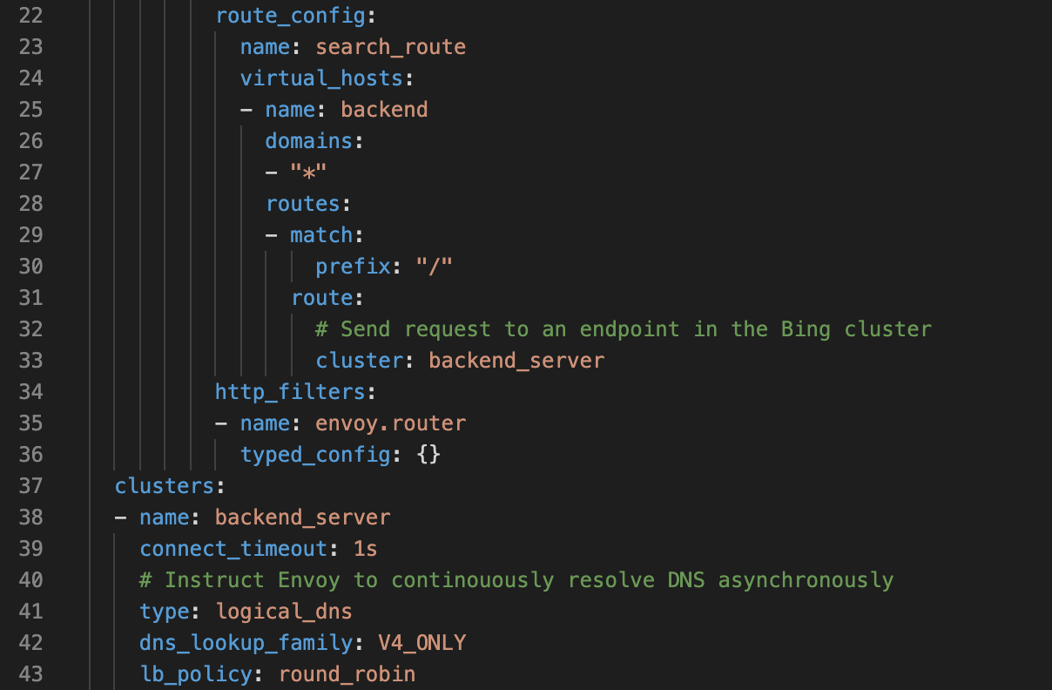
Envoy - Configuration

Slide 26
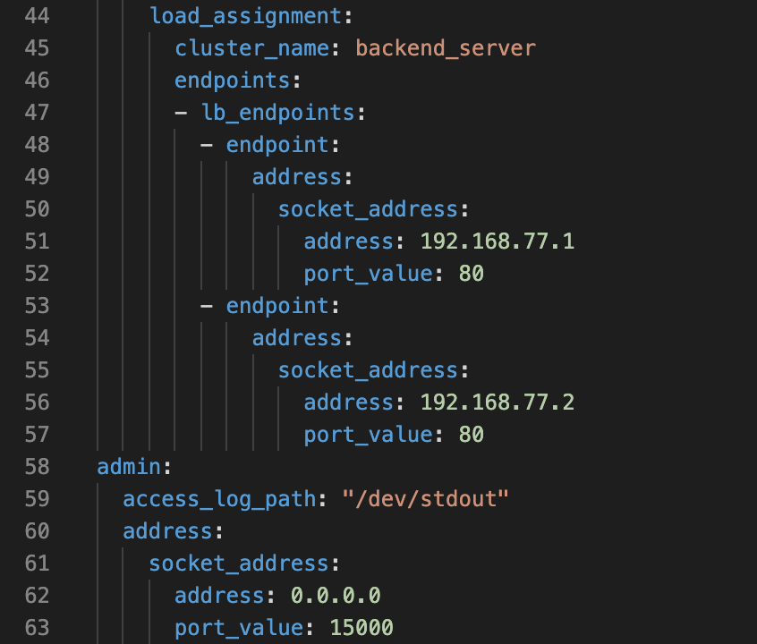
Envoy - Configuration

Slide 27
Envoy - Configuration
YAML file format
Basic concept is same as haproxy
Listen (frontend) address
Backend addresses
Healthy Checks
https://www.envoyproxy.io/learn/health-check
Routes

Slide 28
Envoy - Run
envoy -c config.yaml

Slide 29
Envoy - Reference
https://www.envoyproxy.io/docs/envoy/latest/
https://blog.getambassador.io/envoy-vs-nginx-vs-haproxy-why-the-open-source-ambassador-api-gateway-chose-envoy-23826aed79ef

